Slide 2
xAI-Proj-M
Robust Machine Learning for real-world challenges
Ali Ostadi
Andreas Schwab

Slide 3
Outline
Introduction
Step 1 – Analyze Data
Step 2 – Compare KNN
Step 3
Results
Discussion

Slide 4
Introduction
Project Structure
Step 1: Analyze Data
Step 2: Simple KNN | Simple Linear Layer Step 3: ForestKNN
Goal: Explore Embedding Space with (enhanced) KNN to classify on a Test set
Introduction

Slide 5
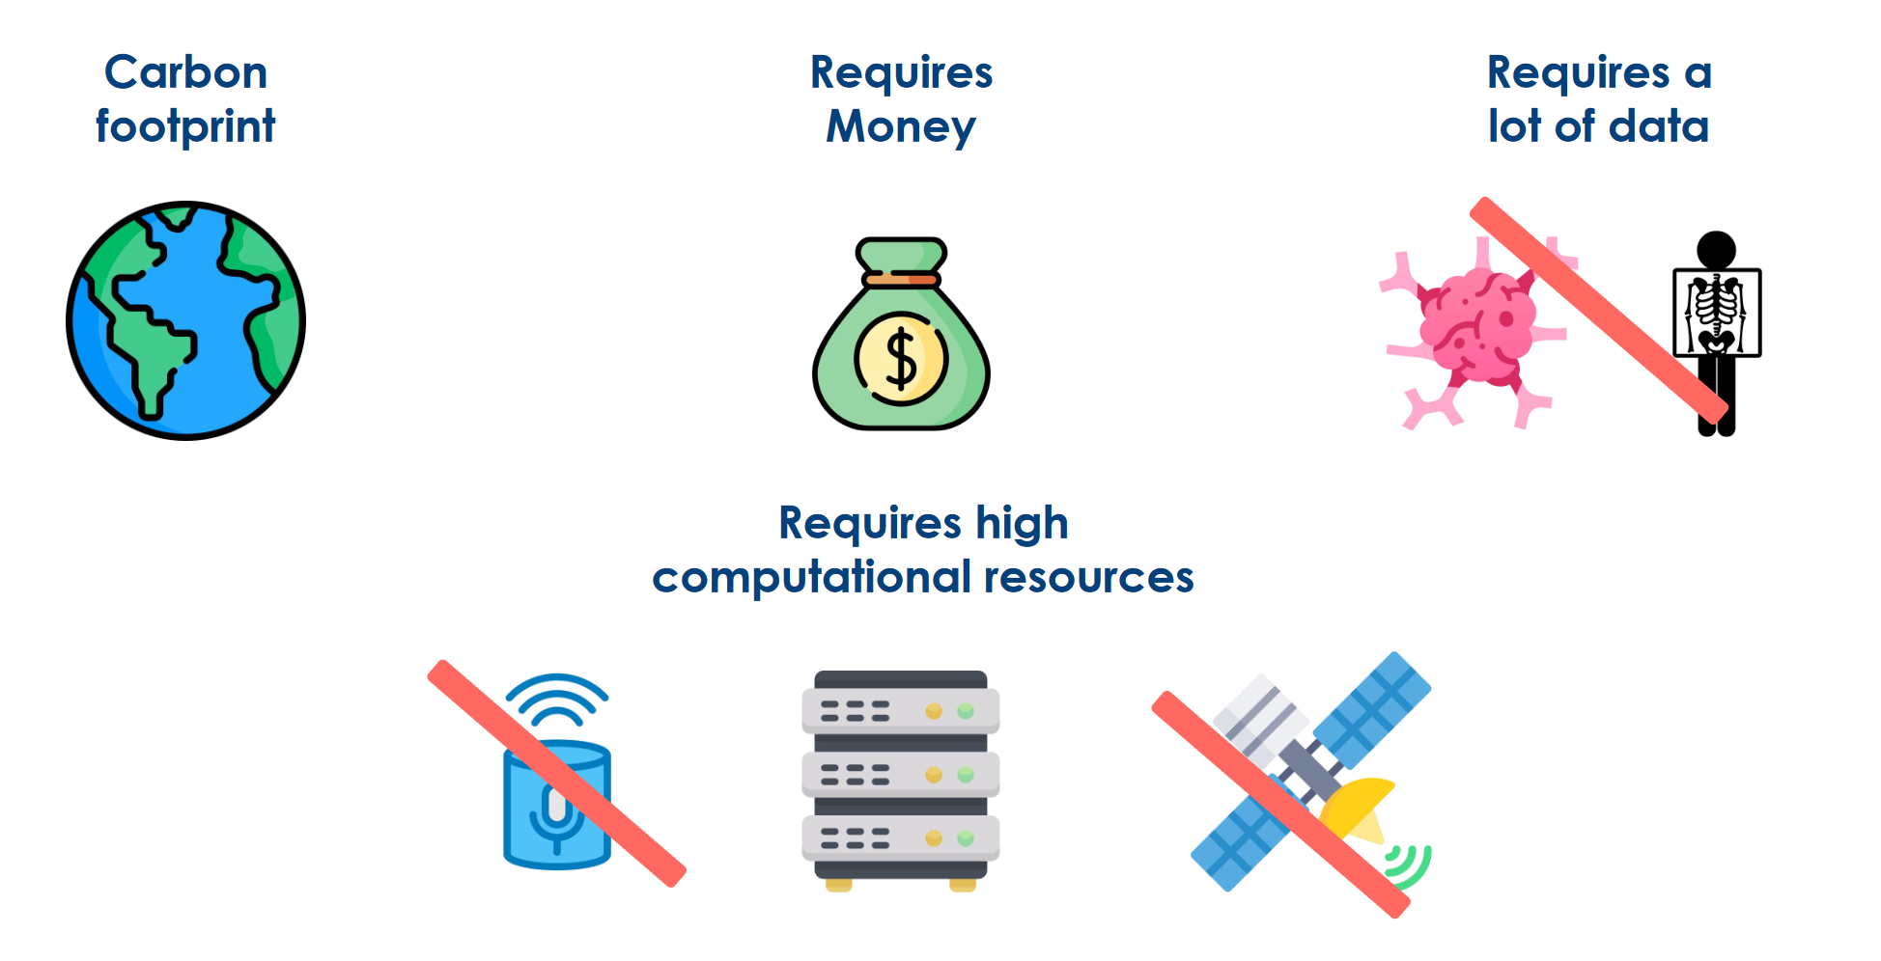
Why KNN?
traditional DL methods...
Introduction

Slide 6
Step 1 – Analyze (Vector) Databases
Step 1

Slide 7
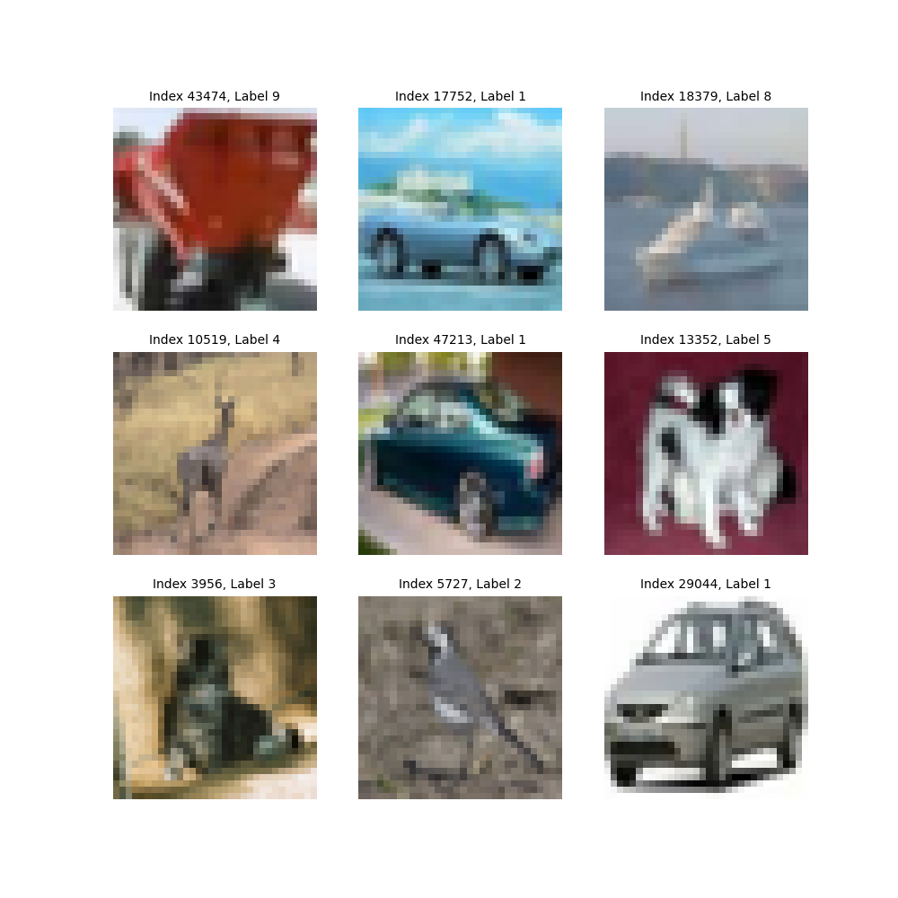
Cifar10
Number of samples 60000 (50.000 Train, 10.000 Test)
Embedding dimensions 768
Number of unique labels: 10 (each 5000 samples)
Step 1

Slide 8
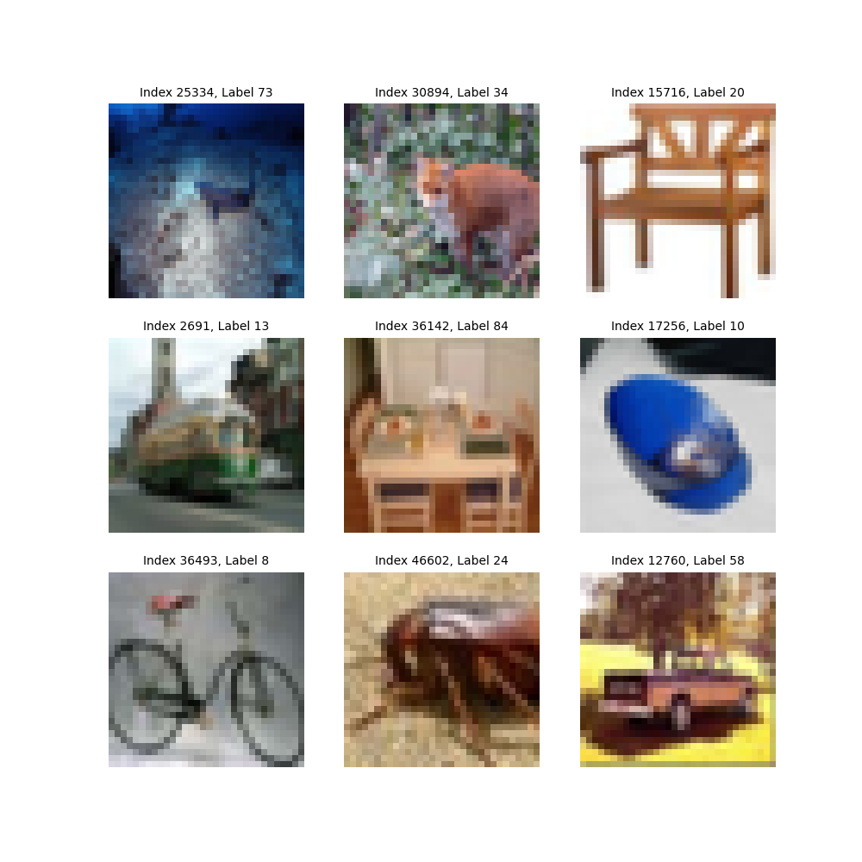
Cifar100
Number of samples 60000 (50.000 Train, 10.000 Test)
Embedding dimensions 768
Number of unique labels: 100 (each 500 samples)
Step 1

Slide 9
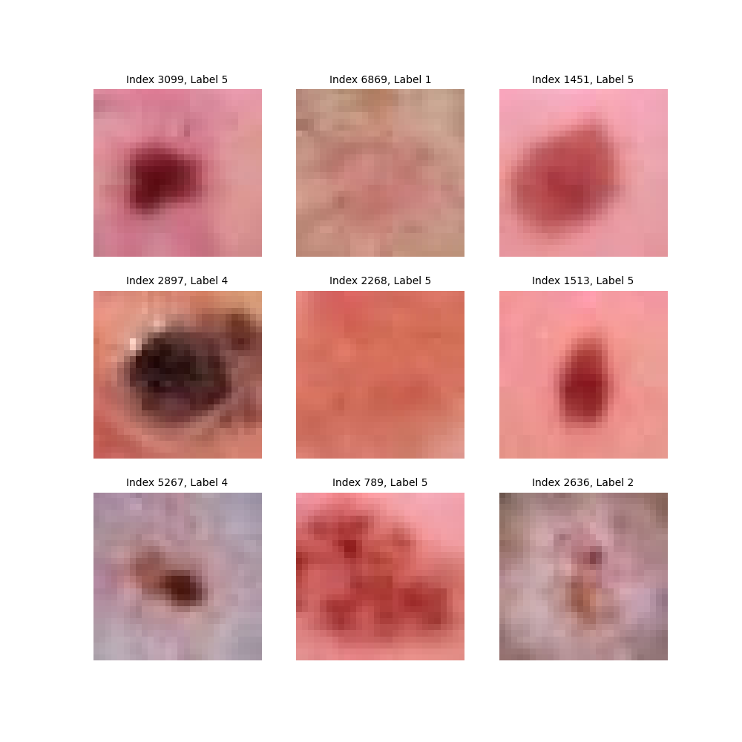
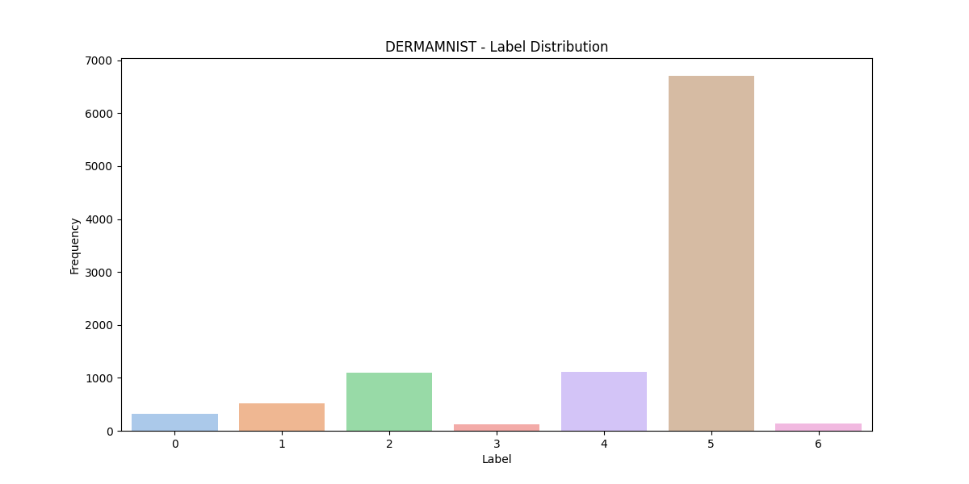
DermaMNIST
Number of samples 10015 (7007 Train, 2005 Test, 1003 Val)
Embedding dimensions 768
Number of unique labels: 7
Step 1

Slide 10
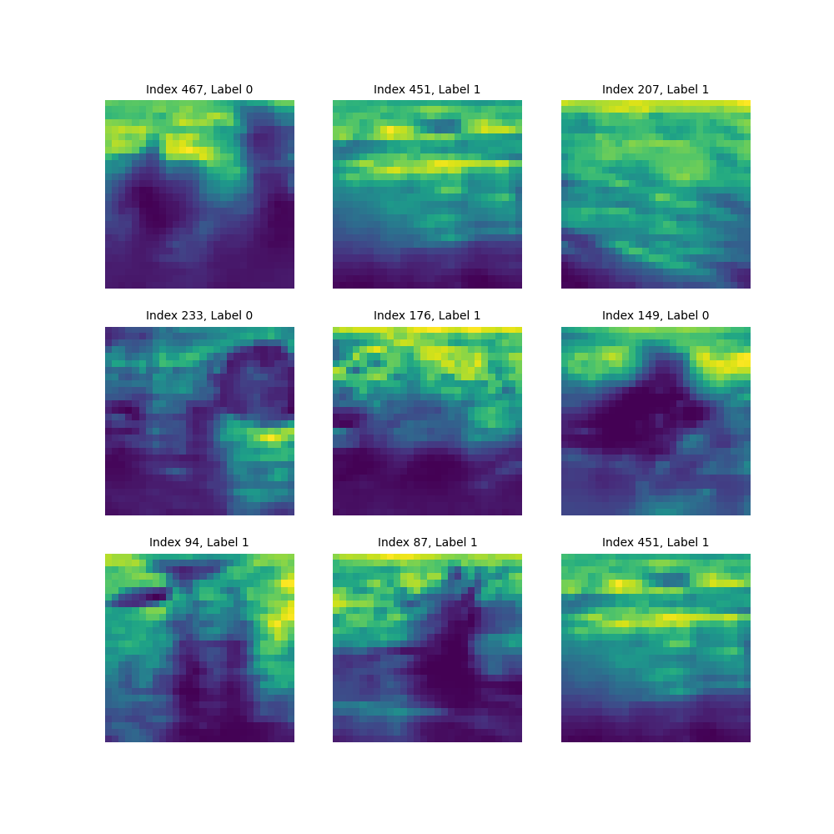
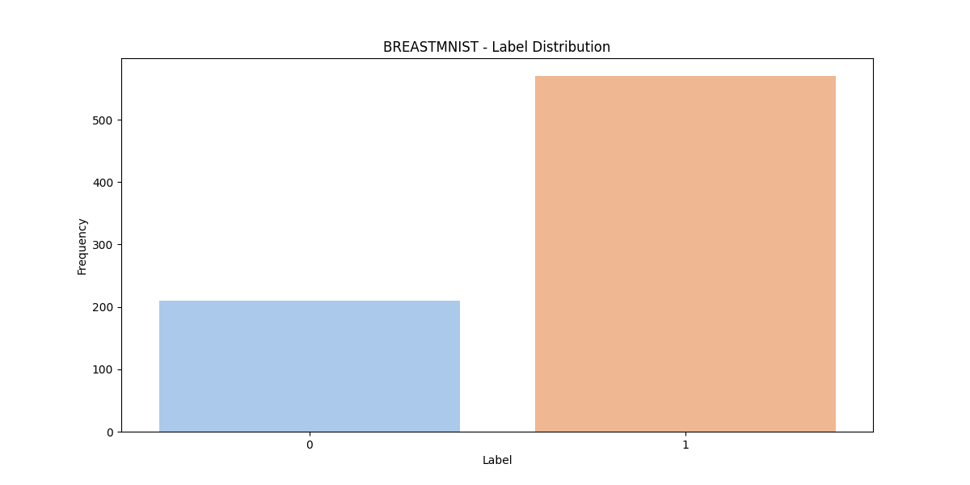
BreastMNIST
Number of samples 780 (546 Train, 156 Test, 78 Val)
Embedding dimensions 768
Number of unique labels: 2
Step 1

Slide 11
Step 1 – Explore Data Distribution
Step 1

Slide 12
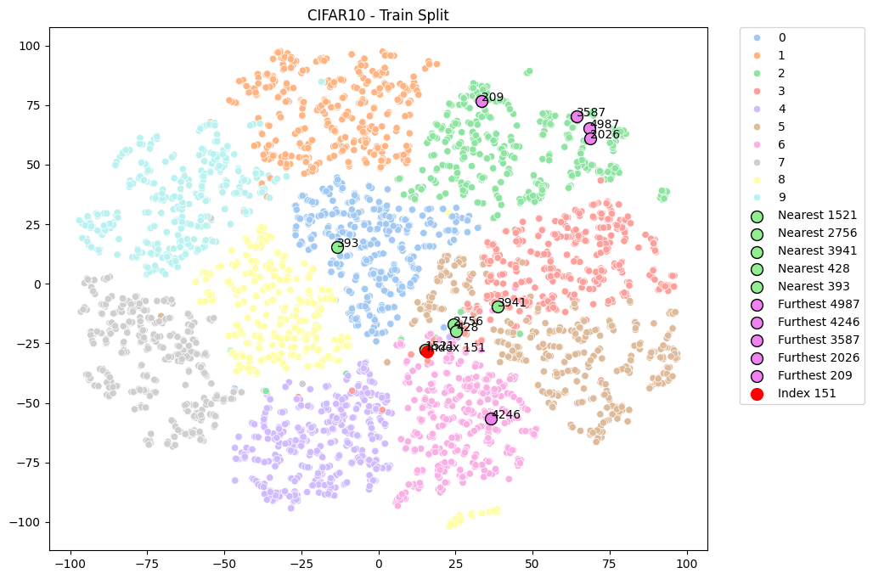
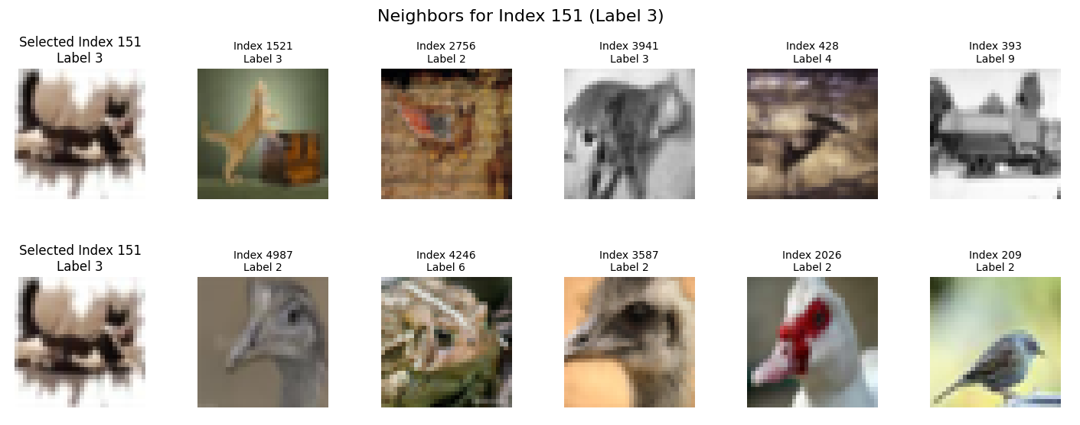
Step 1

Slide 13
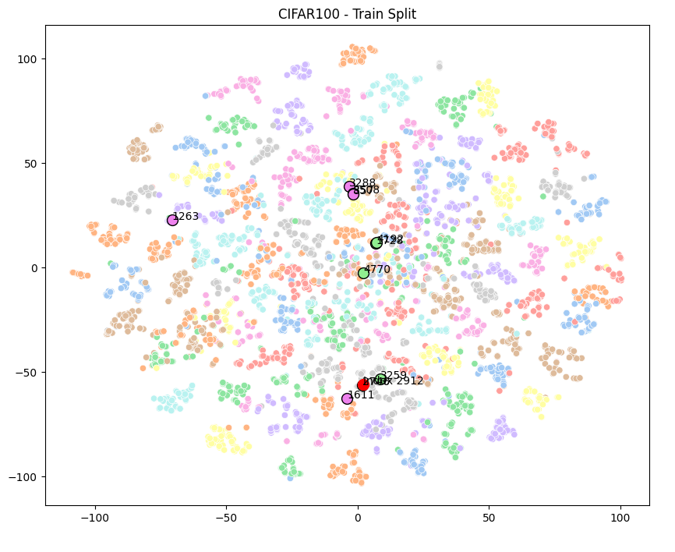
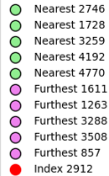
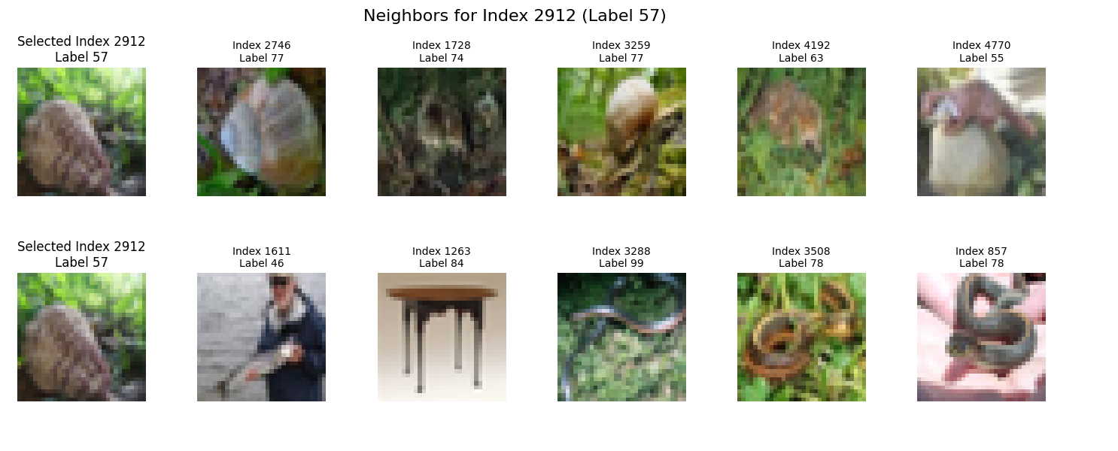
Step 1

Slide 14
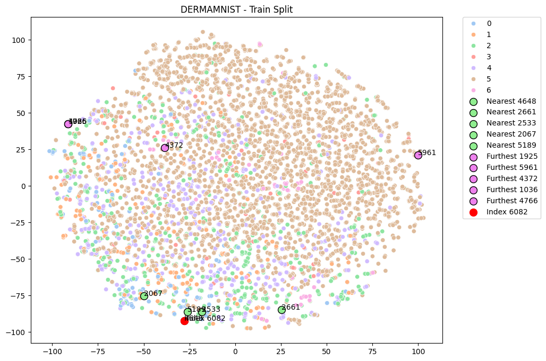
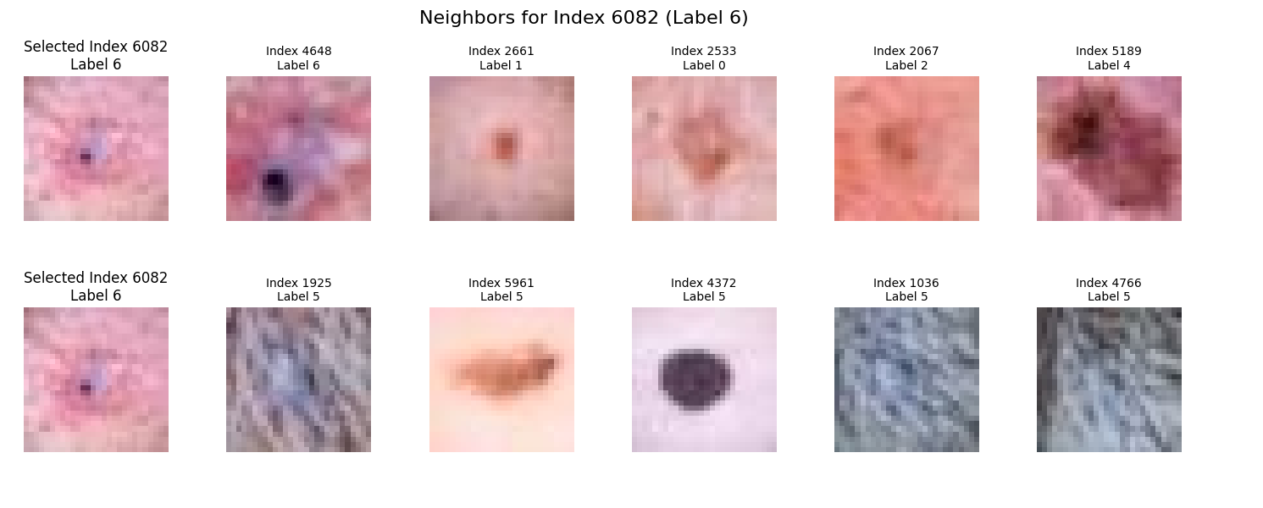
Step 1

Slide 15
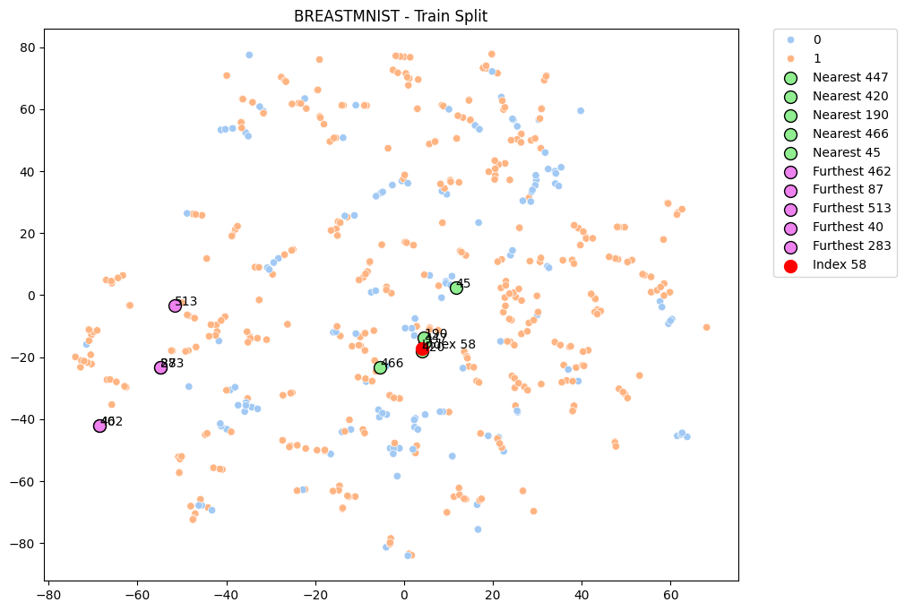
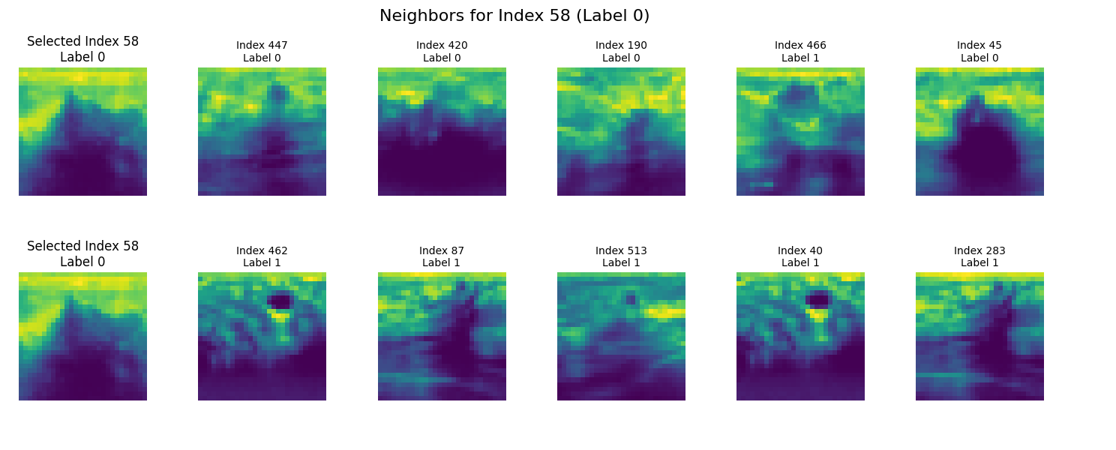
Step 1

Slide 16
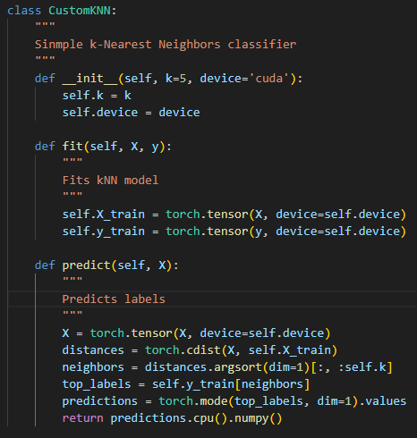
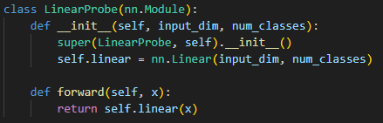
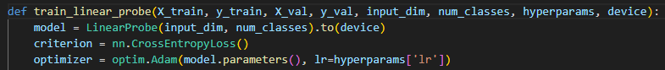
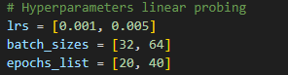
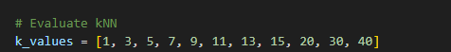
Step 2 – KNN | Linear Layer
Step 2

Slide 17
Step 3 – ForestKNN
Step 3

Slide 18
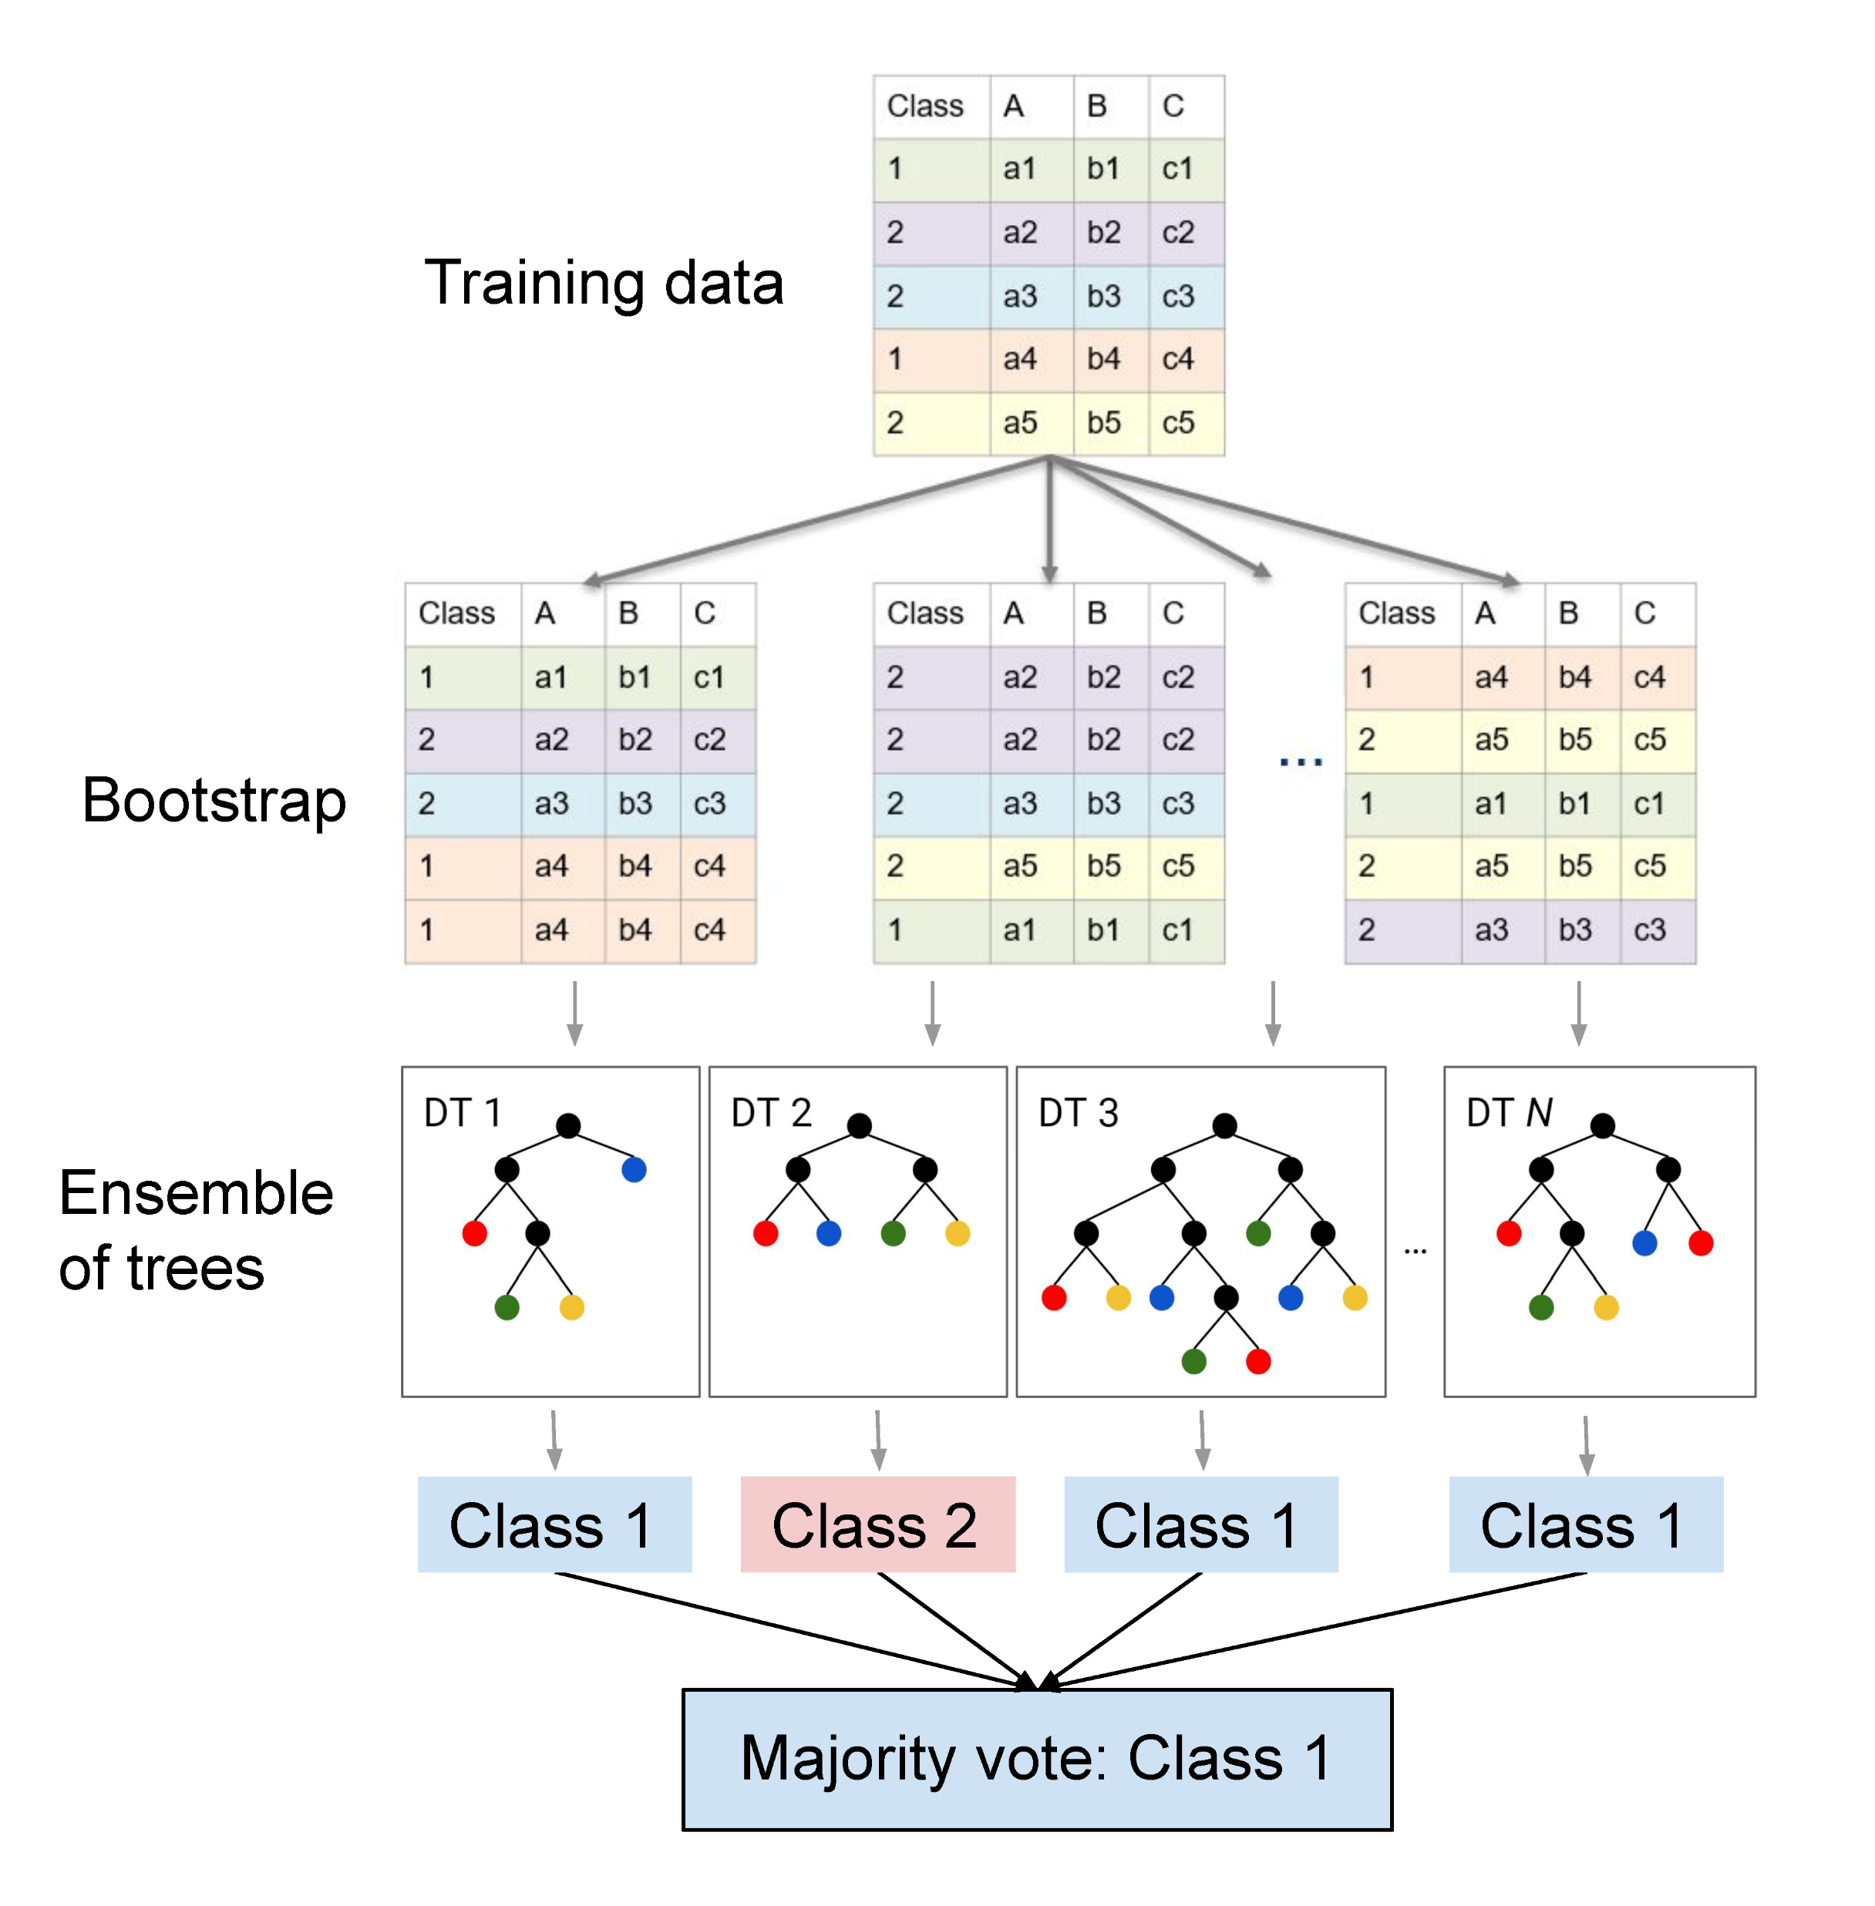

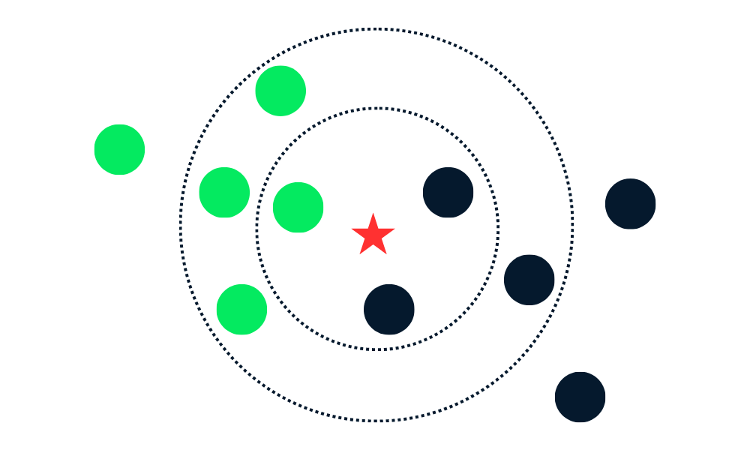


Random Forests + KNN
KNNs
Step 3

Slide 19
Purpose method
Data Bootstrapping
(stratified, balanced, oob, smote)
Feature Projection
(random, pca)
KNN-Ensemble
(K, distance method, No. estimators)
Hyperparameter tuning using Bayesian optimization
Prediction using majority voting
Step 3

Slide 20
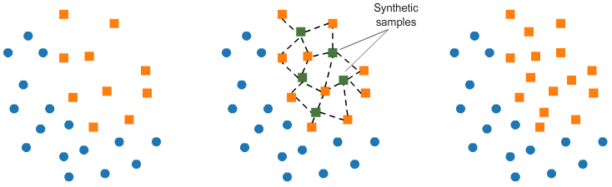
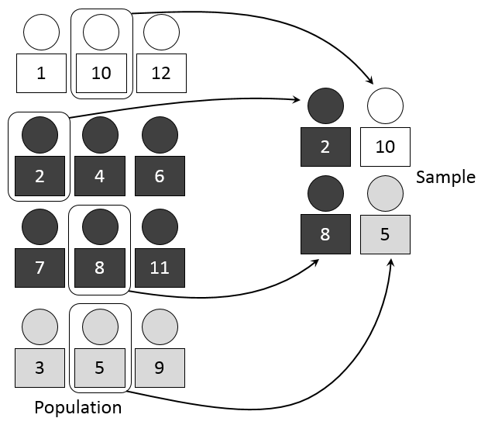
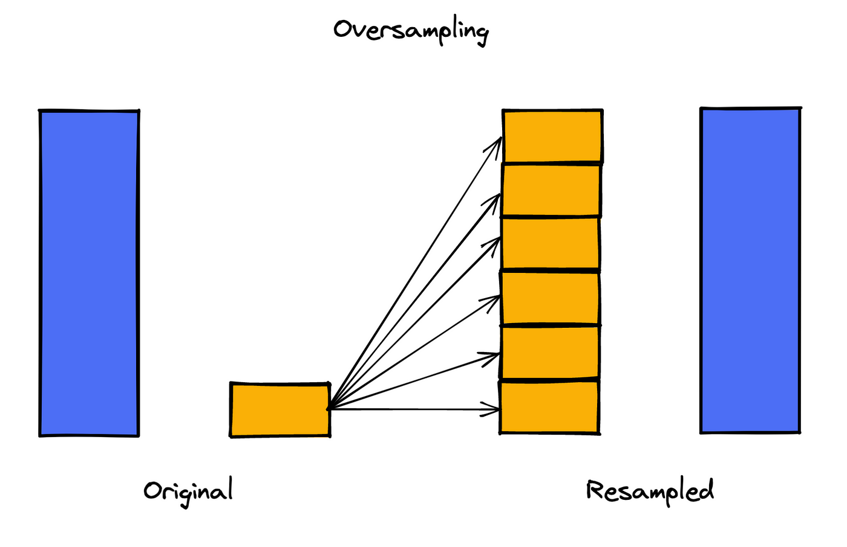
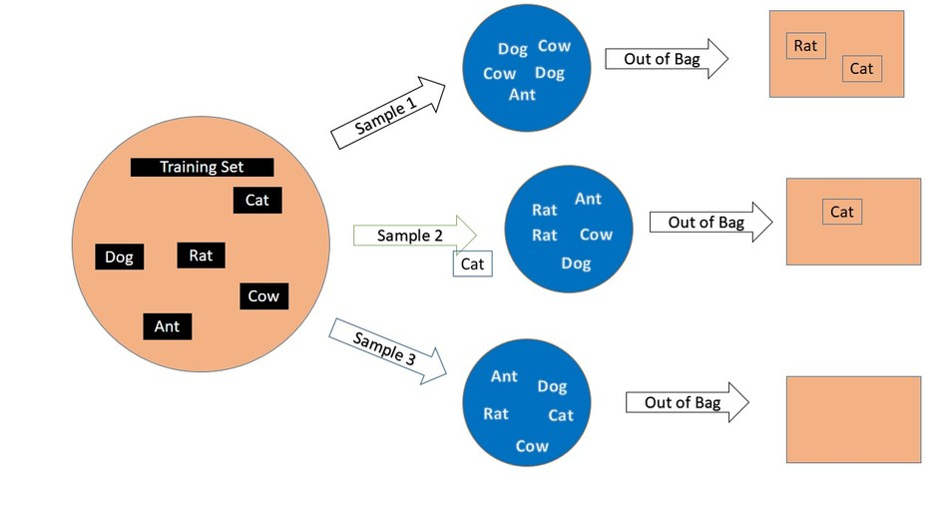
Bootstrapping
SMOTE
stratified
Out of bag
oversampling
Step 3

Slide 21
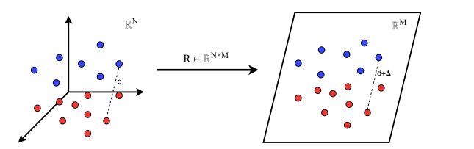
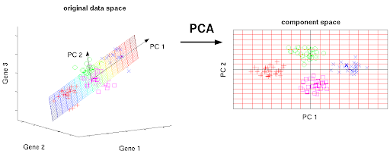
Feature projection
Random gaussian
Principle component analysis
[Source]
[Source]
Step 3

Slide 22
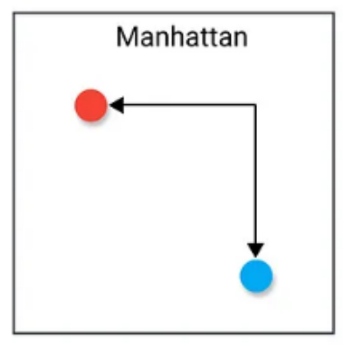
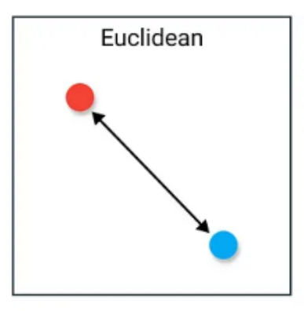
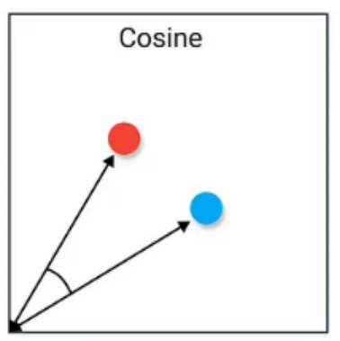
Distance methods
[Source]
[Source]
[Source]
Step 3

Slide 23
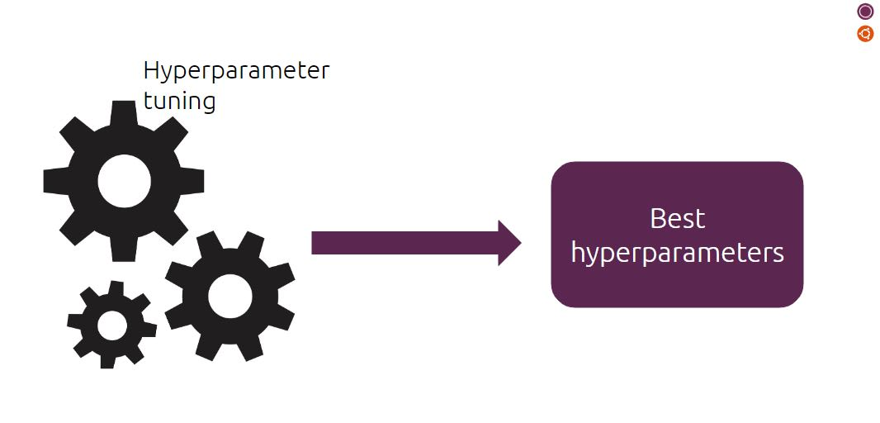
Bayesian optimization
'projection_method': [random, pca],
'n_components': [50, 100, 150],
'variance_threshold': [0.9, 0.95, 0.99],
'k': [3, 5, 10],
'n_classifiers': [10, 20, 30],
'distance_metric': [euclidean, manhattan, cosine],
'sampling_method': [stratified, balanced, oob, smote]
Step 3

Slide 24
Results
Results

Slide 25
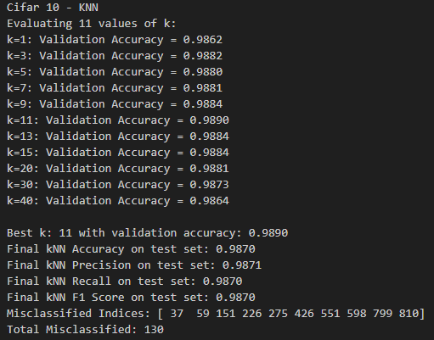
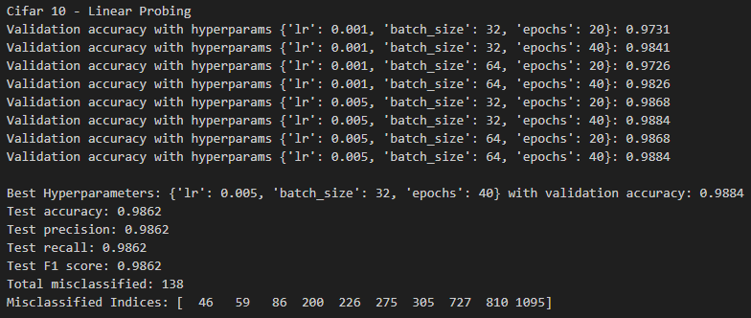
Results: Step 2 - KNN | Linear Layer
Results

Slide 26
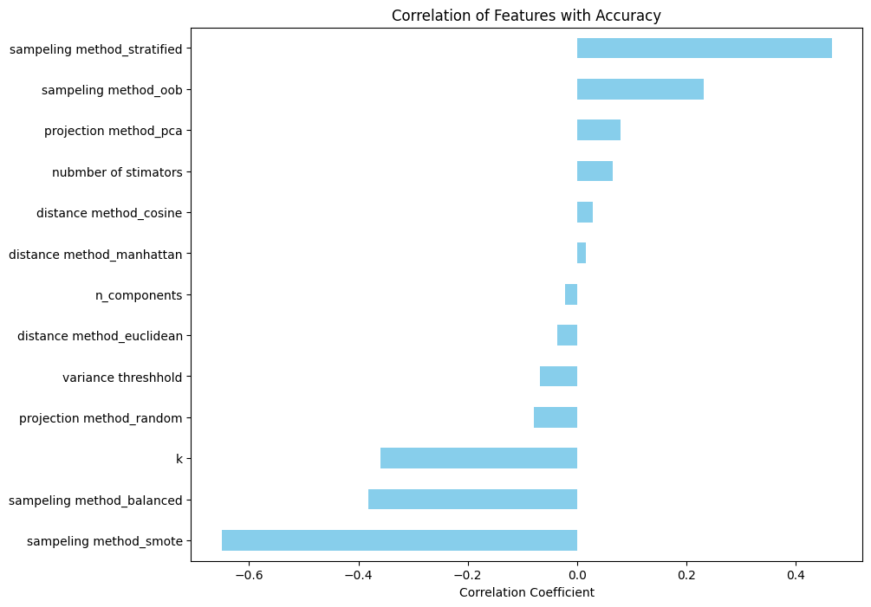
Results: ForestKNN
Results

Slide 27
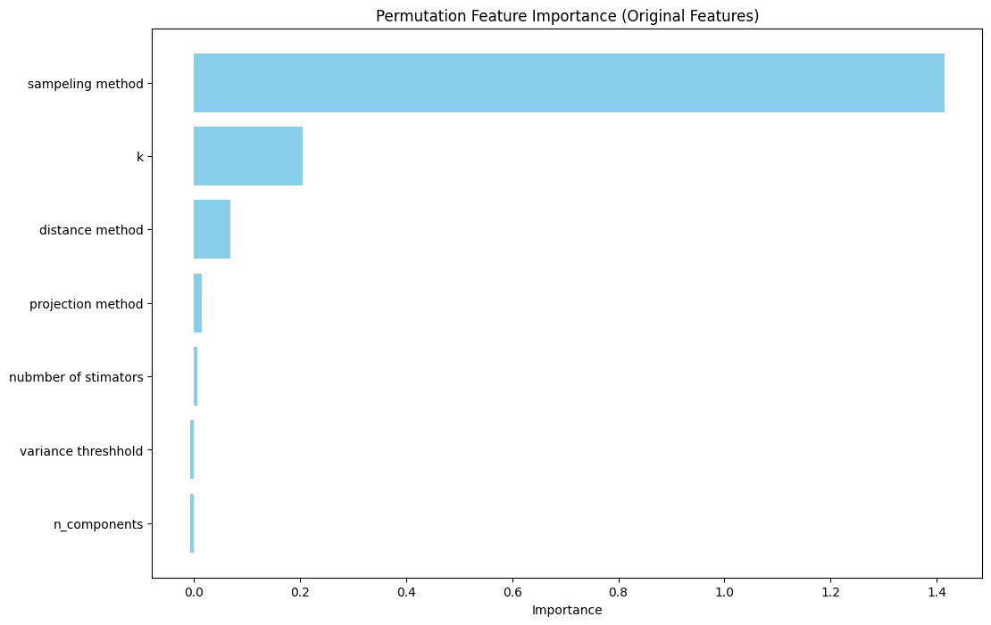
Results: ForestKNN
Results

Slide 28
Discussion
Discussion

Slide 29
Limitations
Discussion

Slide 30
Questions?

